Slide 1






Capstone_A Project C1_G7
Shop For Home
First Step
Second Step
Third Step

Slide 2
Project C1_G7 Team member
Names
Vijay Mohan Joshi

Slide 3
Shop For Home
Home shoping is a popular store in the market which allows consumers to shop for goods from the privacy of their own home, as opposed to traditional shopping, which requires one to visit brick and mortar stores and shopping malls.
To work with above web applications there are two
users:-
User
Admin

Slide 4
Hence, Hence, This is an E-Commerse web application where it provides convenience to the coustomers like:-
Saves time and efforts.
The convenience of shopping at home.
Wide variety/range of products are available.
Good discounts / lower prices.
Get detailed information about the product.
We can compare various models/brands.

Slide 5
User Stories :-
As a user I should be able to login, Logout and Register into the application.
As a user I should be able to see the products in different categories.
As a user I should be able to sort the products.
As a user I should be able to add the products into the shopping cart.
As a user I should be able to increase or decrease the quantity added in the
cart.
As a user I should be able to add “n” number of products in the cart.
As a userIshould be able to gettheWishlist option where I can add those
products which I want but don’t want to order now.
As a user I should get different discount coupons.

Slide 6
Admin Stories :-
As an Admin I should be able to login, Logout and Register into the application.
As an Admin I should be able to perform CRUD on Users.
As an Admin I should be able to Perform CRUD on the products.
As an Admin I should be able to get bulk upload option to upload a csv for
products details
As an Admin I should be able to get the stocks.
As an Admin I should be able to mail if any stock is less than 10.
As an Admin I should be able to get the sales report of a specific duration.
As an Admin I should be able to set the discount coupons for the specific set of
users

Slide 7

System Support
Software Requirements
Technologies:
Angular
Java Spring Boot
Hibernate
Languages:
HTML, CSS, JavaScript
Java
MSQL Databases
IDE:
Eclipse
Vs code
Mysql workbench

Slide 8
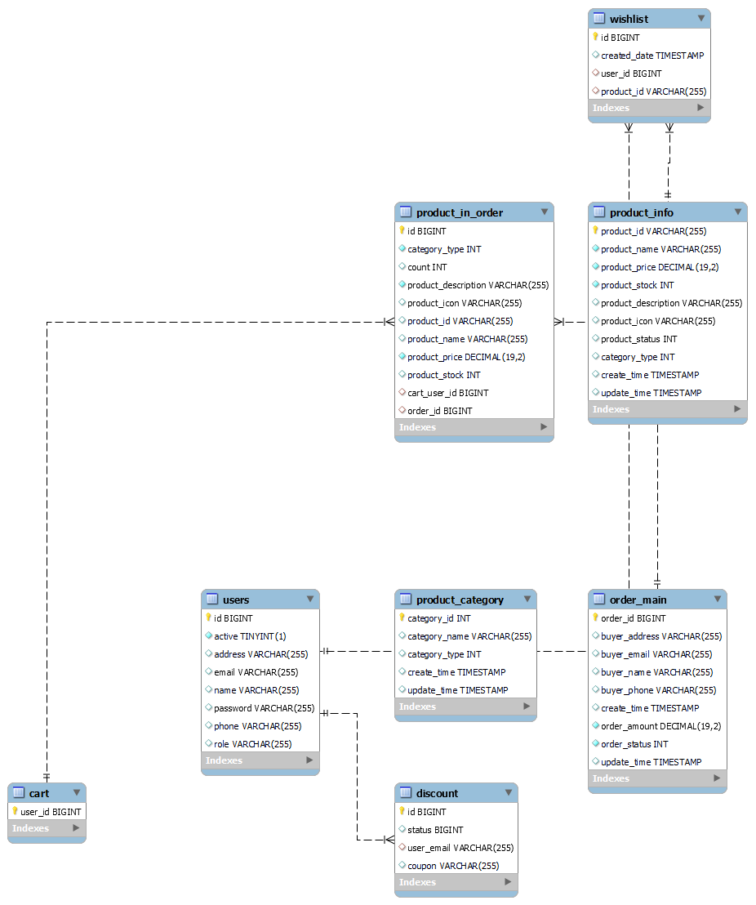

Slide 9
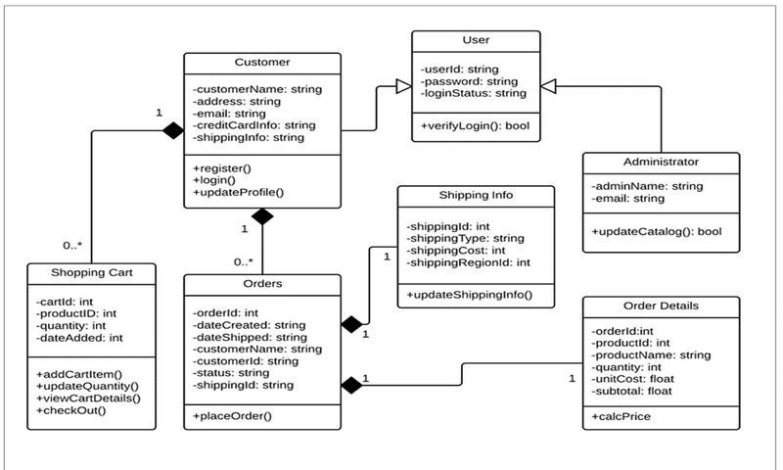
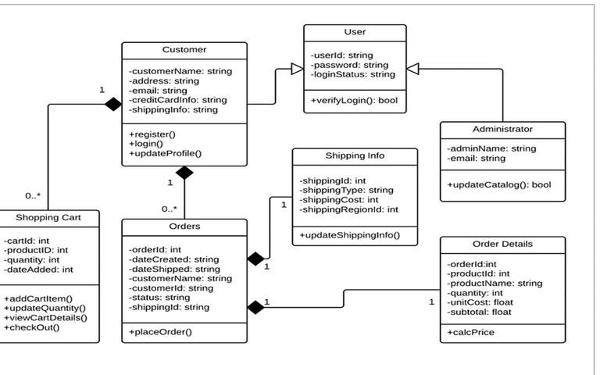

Slide 10
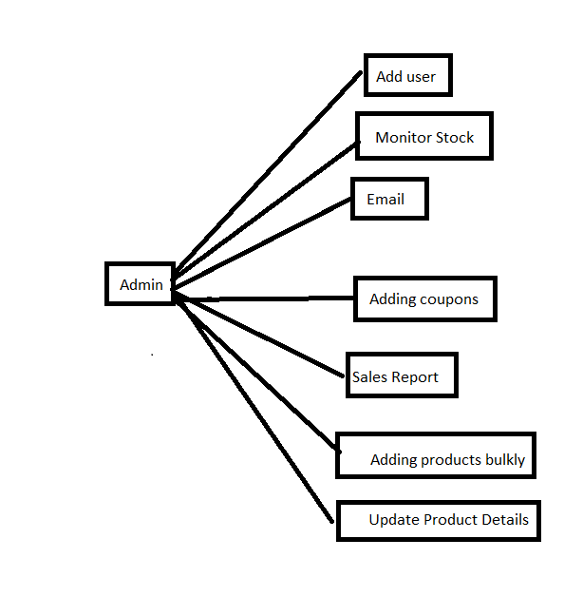
Admin functions:-

Slide 11
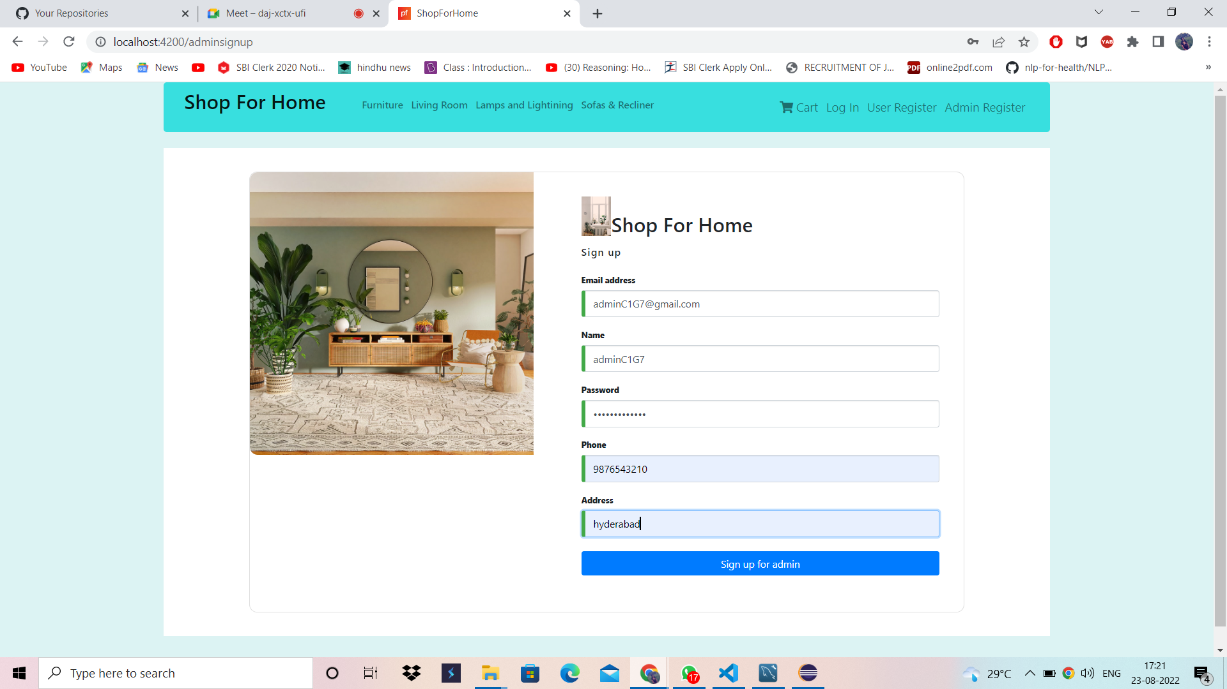

Slide 12
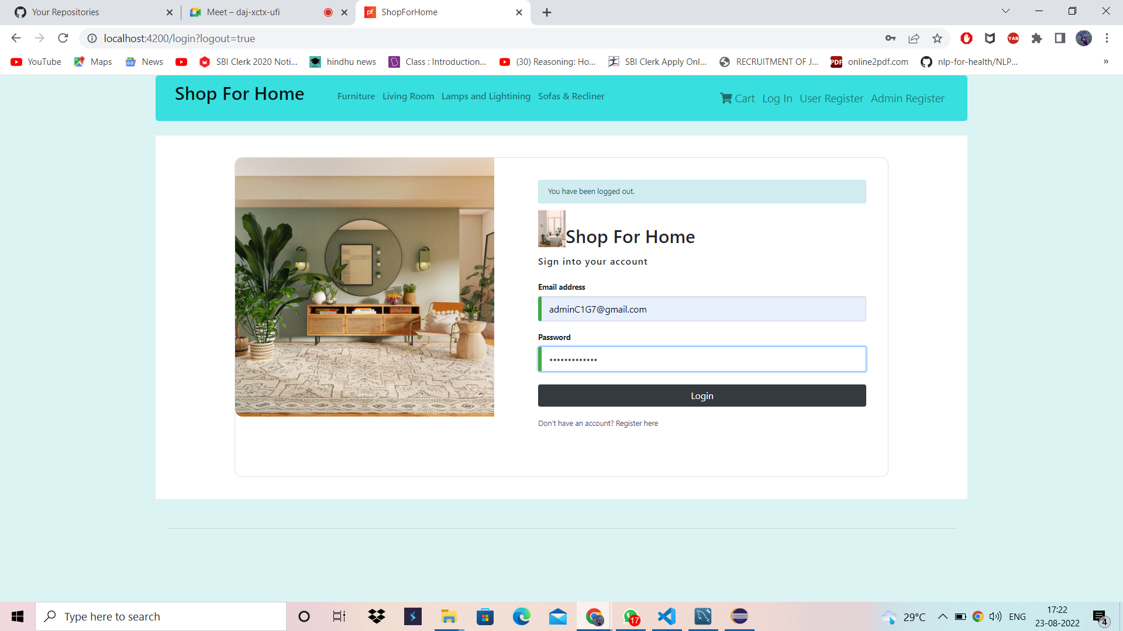

Slide 13
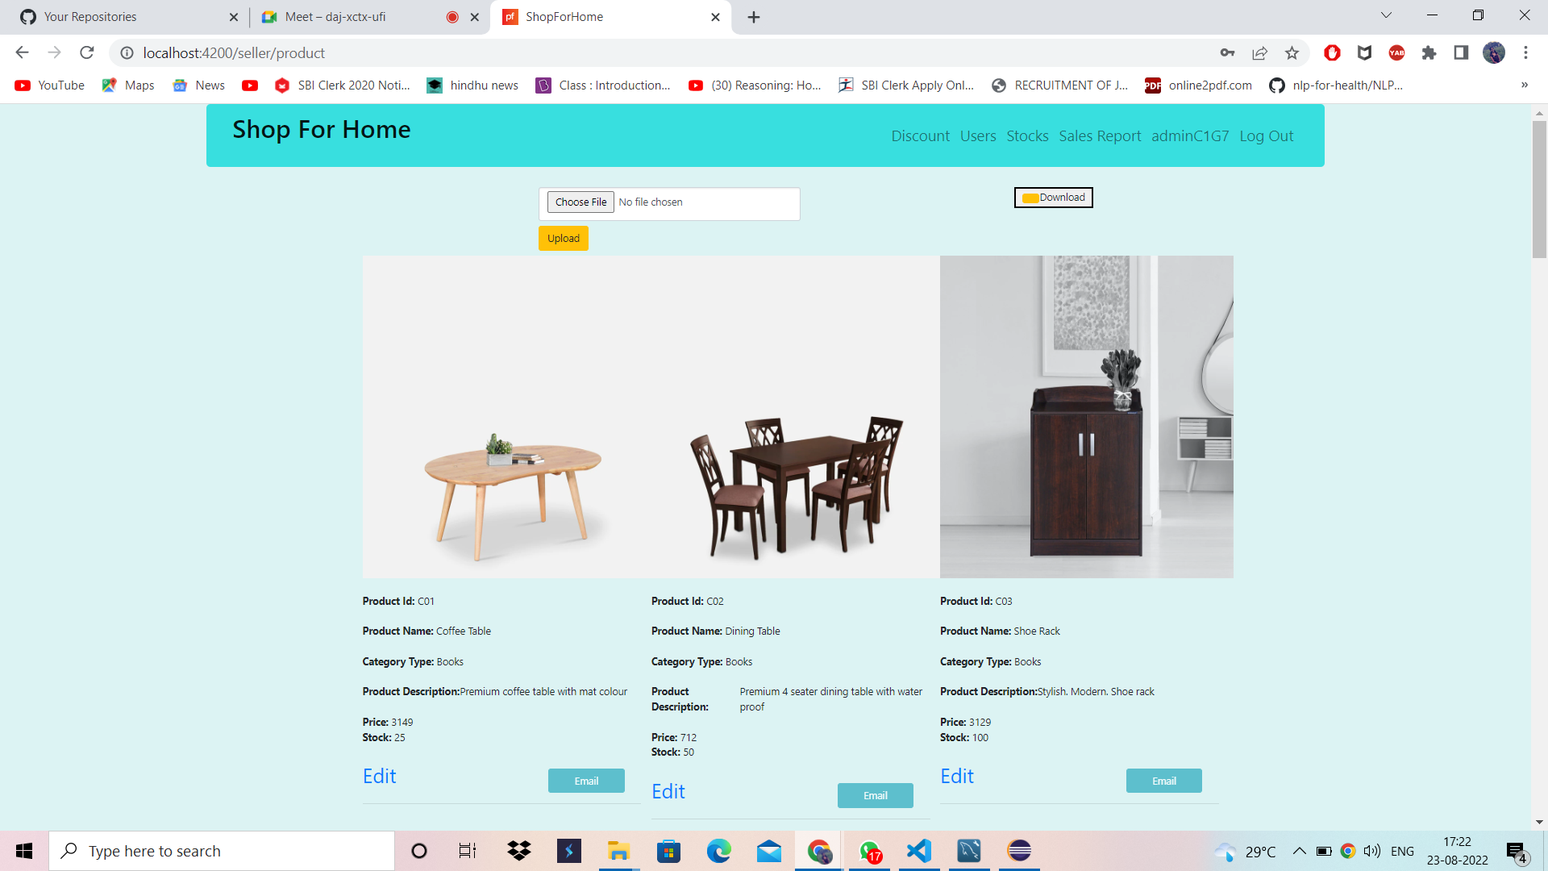

Slide 14
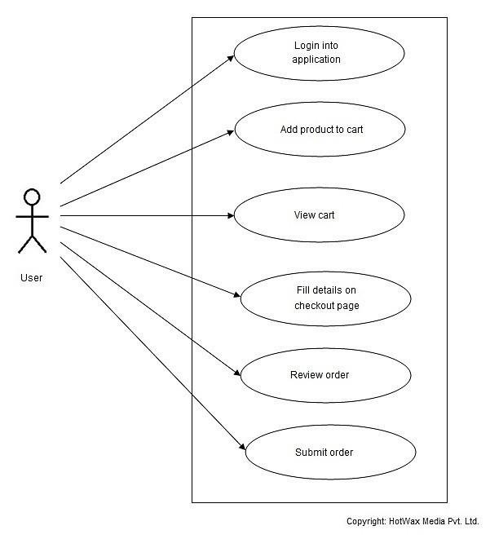
User functions:-

Slide 15
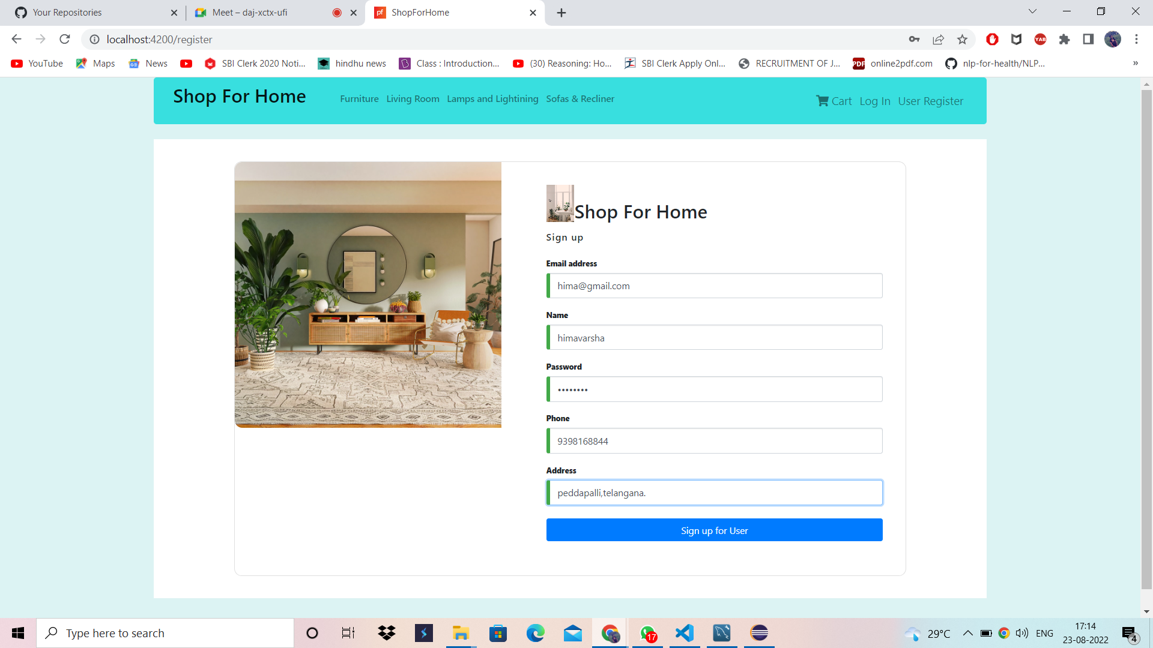

Slide 16
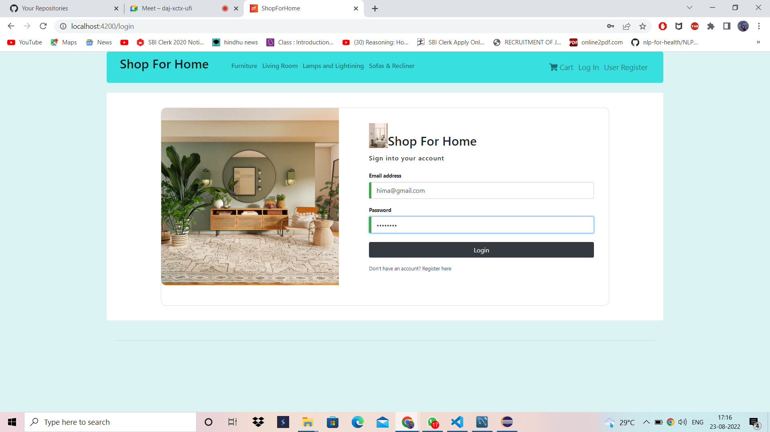

Slide 17
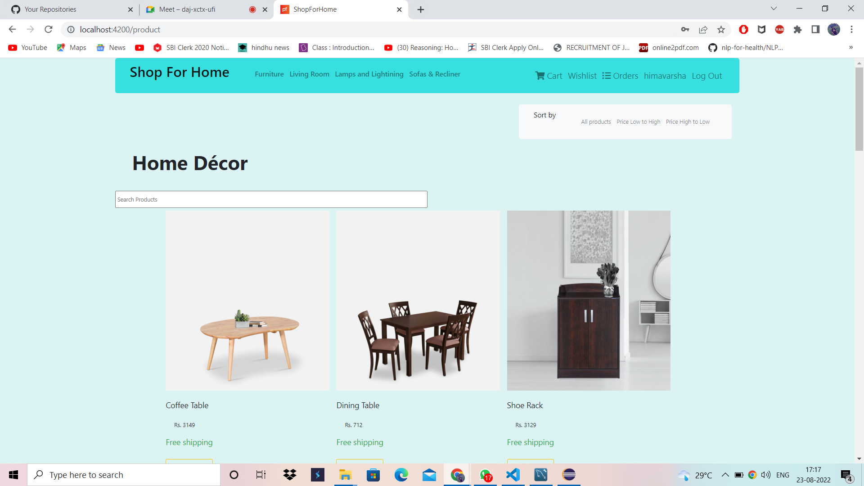

Slide 18
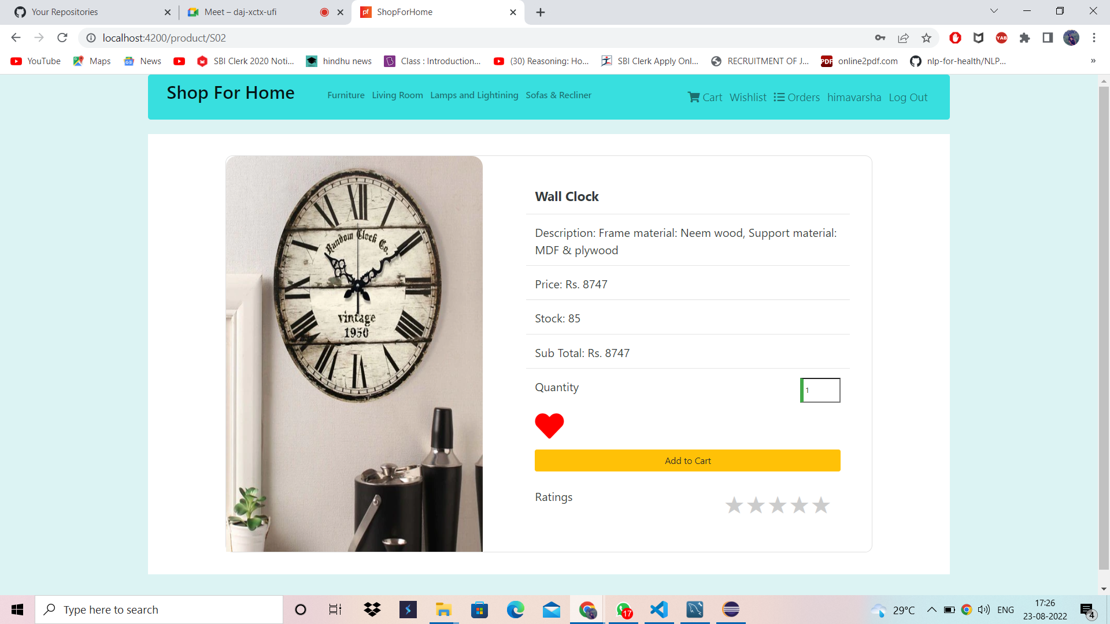

Slide 19
Technology Used:-
Angular Spring Boot
HTML, CSS, JavaScript
Mysql

Slide 20
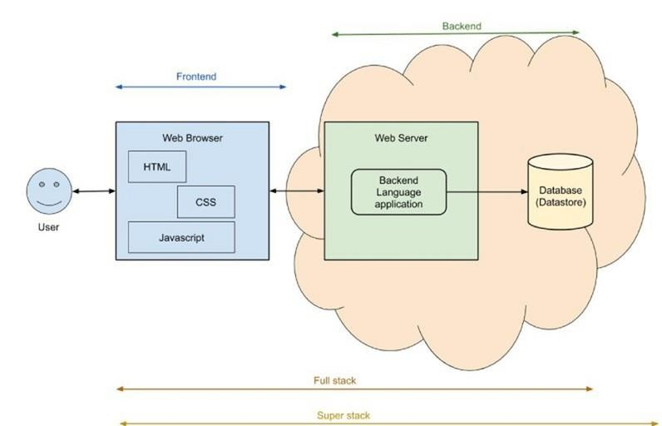

Slide 21

There are main eight blocks of Angular:-
Module Component Metadata Template Data Binding Service Directive
Dependency Injection

Slide 25


Slide 26
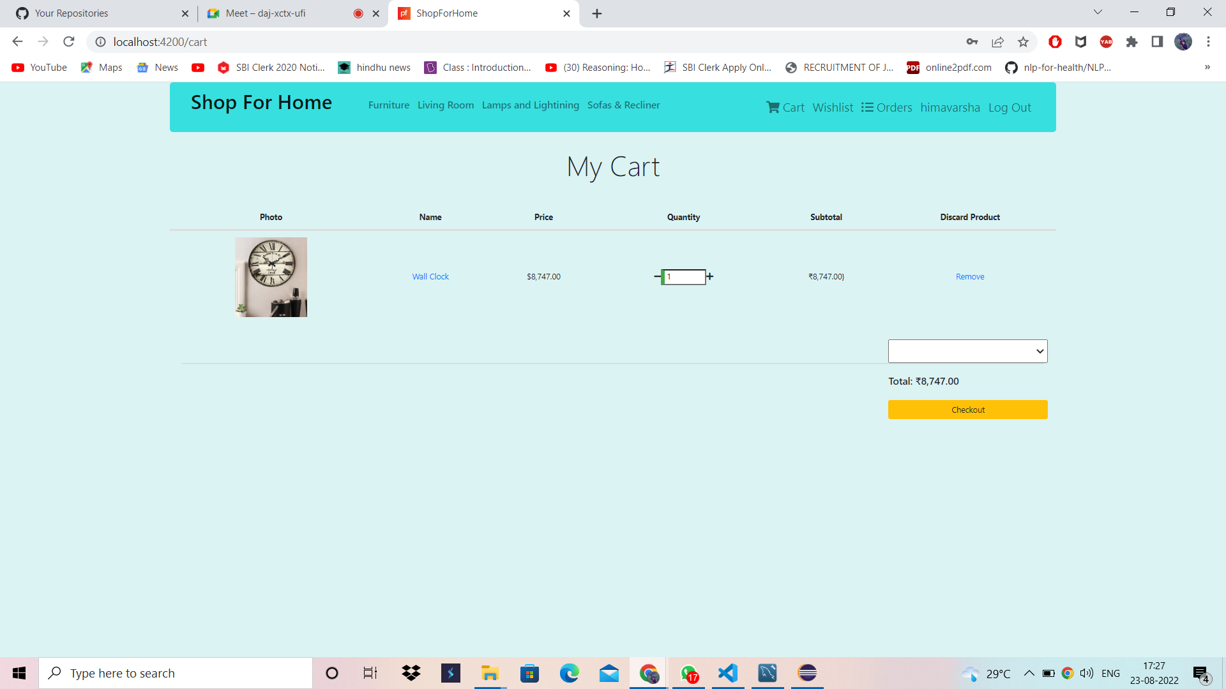

Slide 27
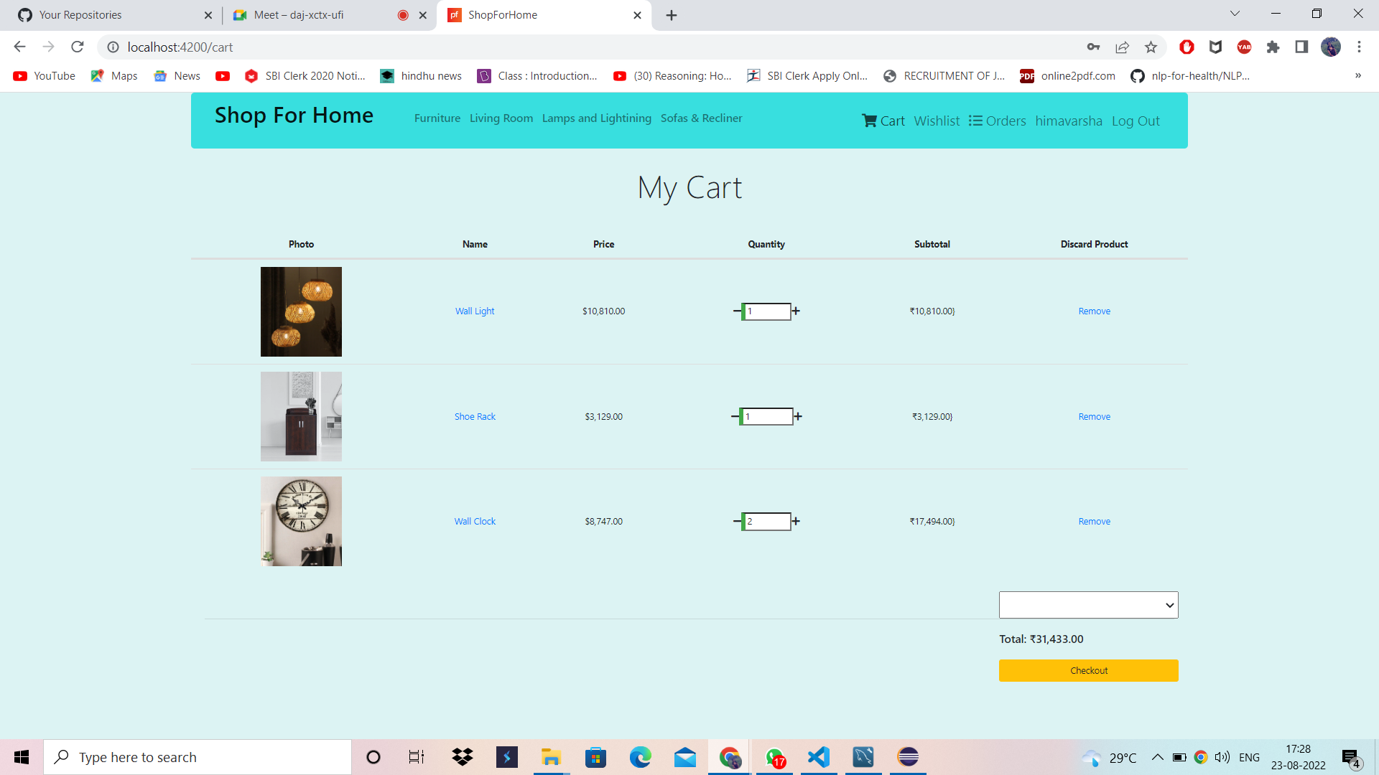

Slide 28
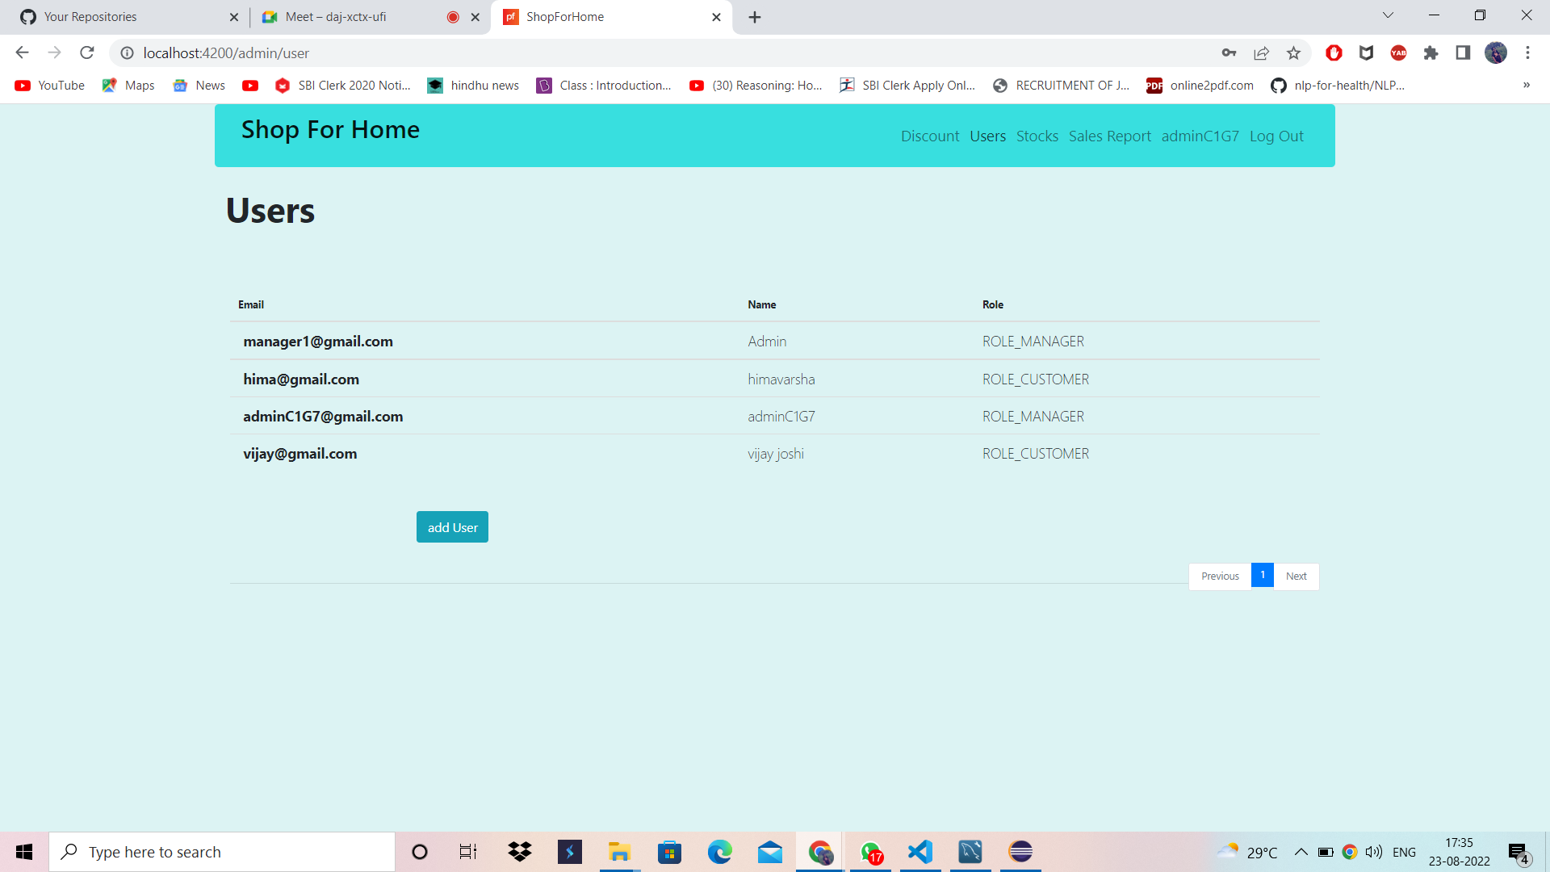

Slide 29
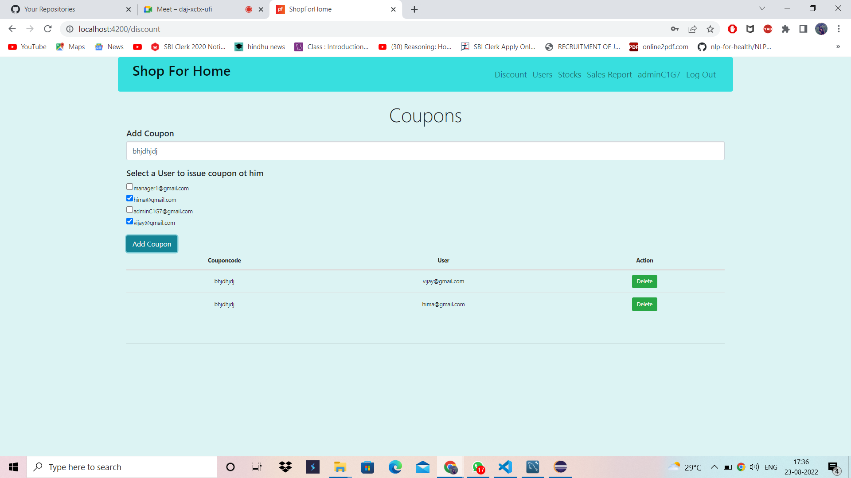

Slide 30
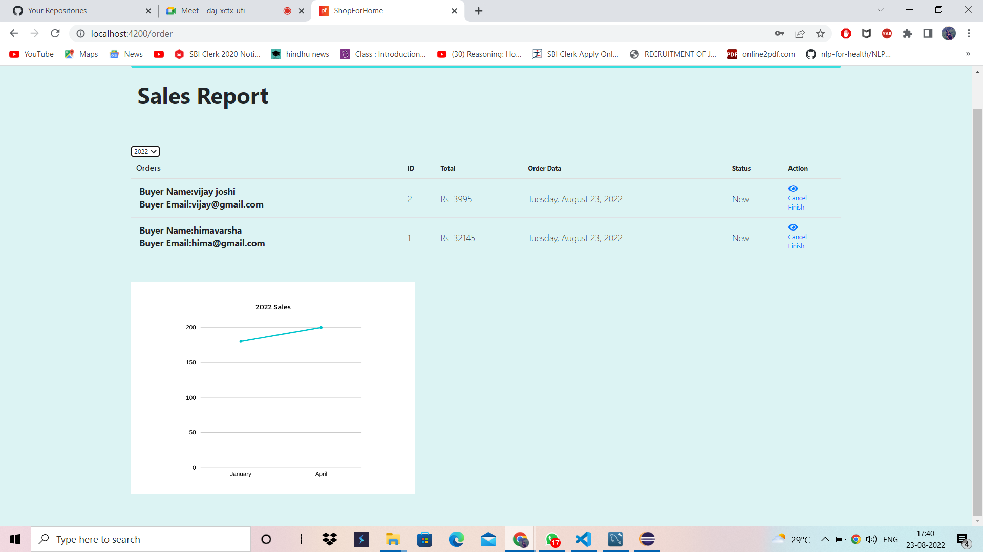

Slide 31
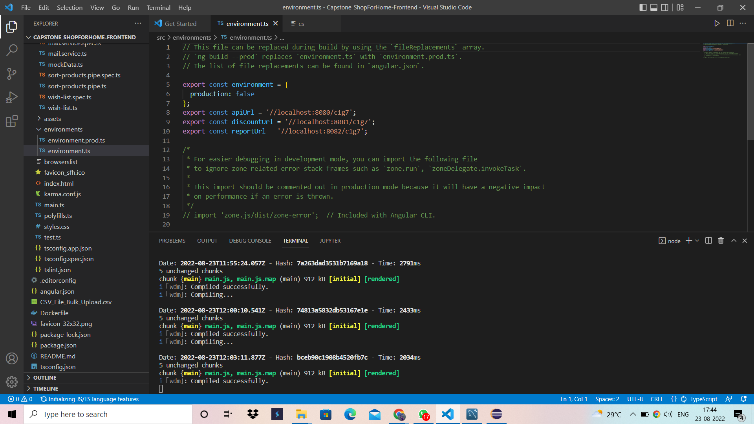

Slide 32



Entities in the Database include :-
Product_Category Product_info Cart
Users product_in_order Order_main Wishlist

Slide 33



Technologies Used:-
Java Spring Boot
Spring Security JWT
Hibernate MYSQL
Maven

Slide 34




The spring boot consists of the following four layers:-
Presentation Layer – Authentication & Json
Translation
Business Layer – Business Logic, Validation &
Authorization
Persistence Layer – Storage Logic Database Layer – Actual Database

Slide 35
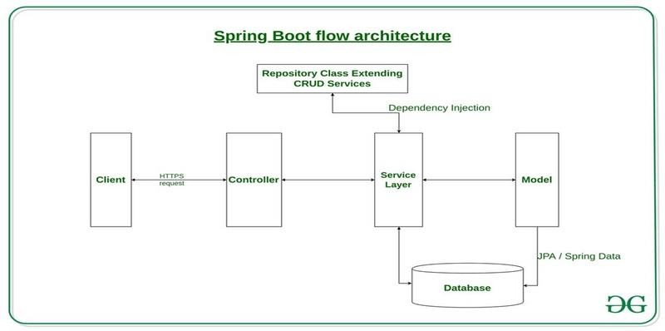

Slide 36
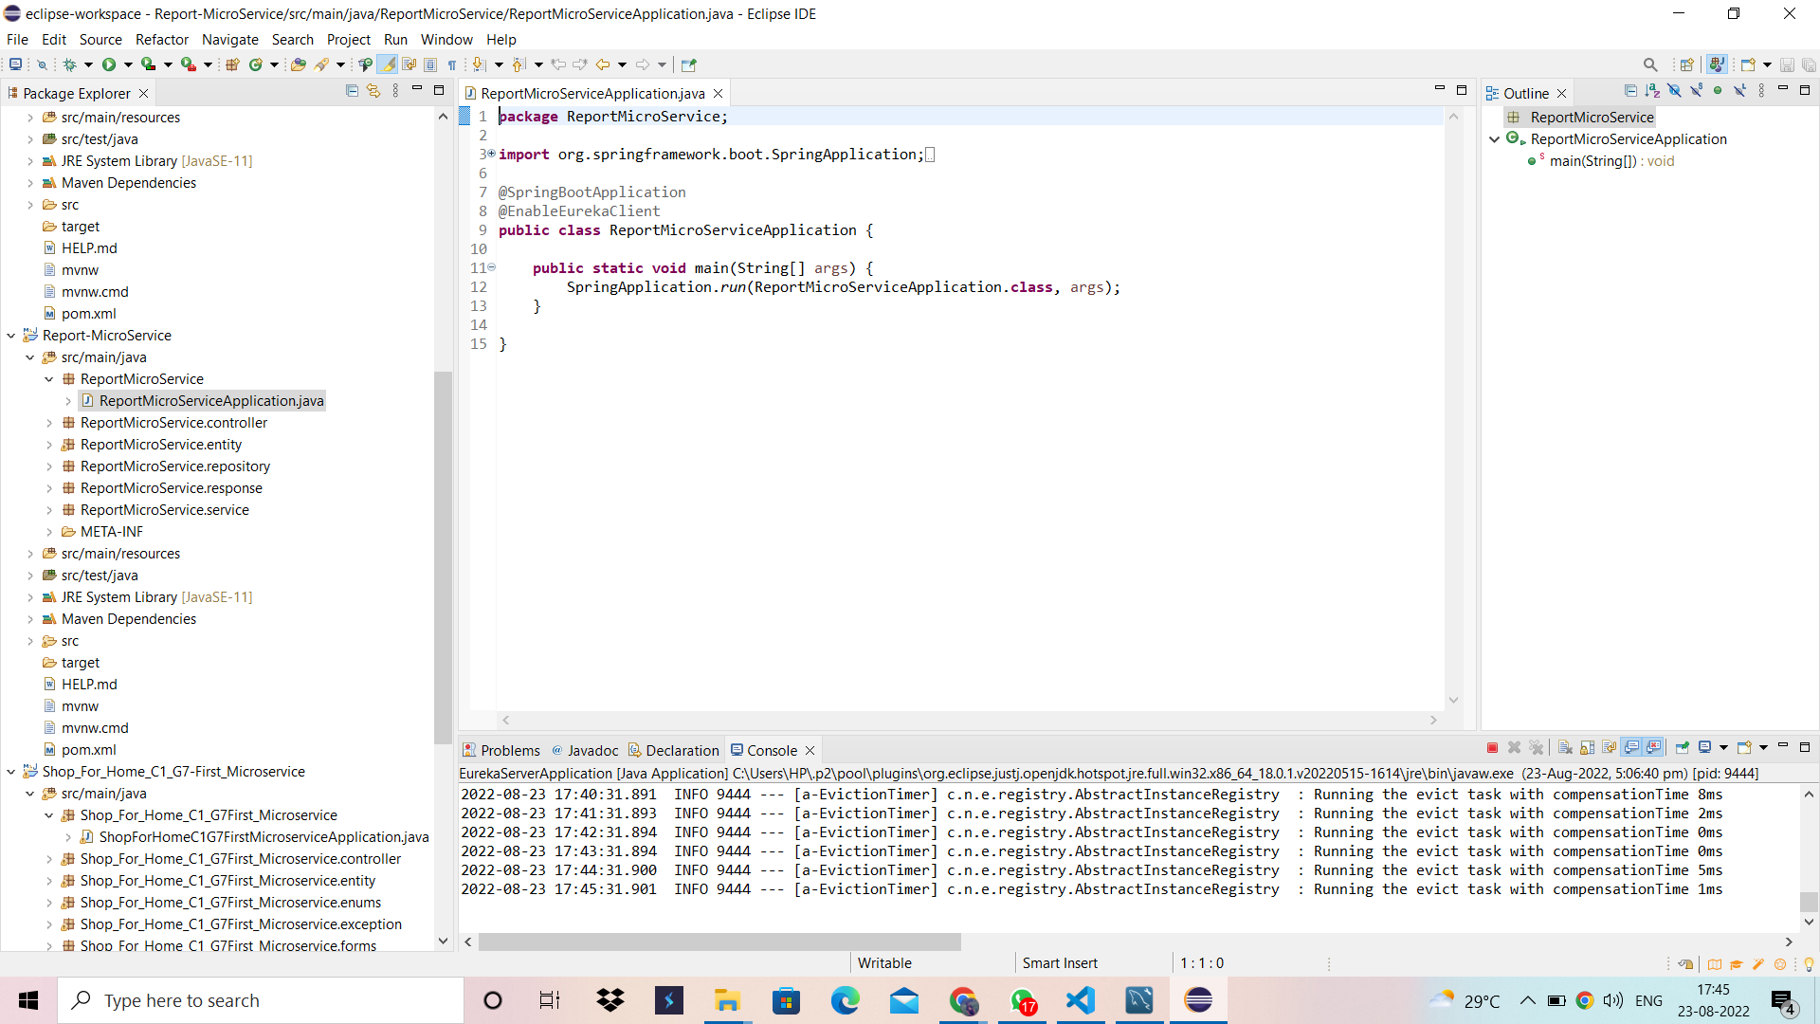

Slide 37
Microservices:-
microservices is nothing but a build an application by splitting its business components into small services that can be deployed and operated independently from each other.
Typically, micro services are used to speed up application development.
Micro services architectures built using Java are common, especially Spring Boot ones.

Slide 38
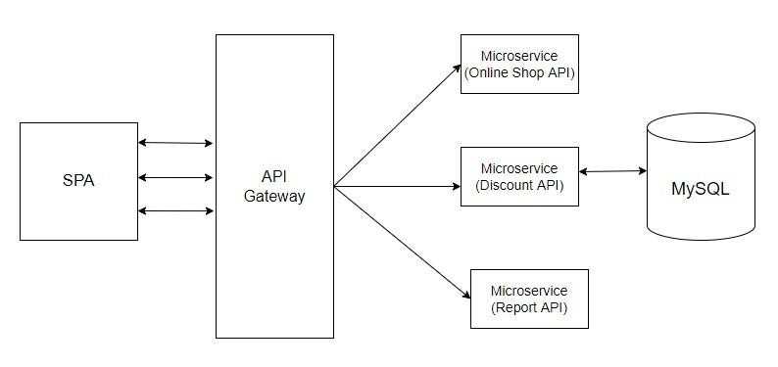
Microservices Architecture:-

Slide 39

Components of microservices architecture
Microservices. Microservices make up the foundation of a microservices architecture. ...
Containers. ... Service mesh. ... Service discovery. ... API gateway.

Slide 40
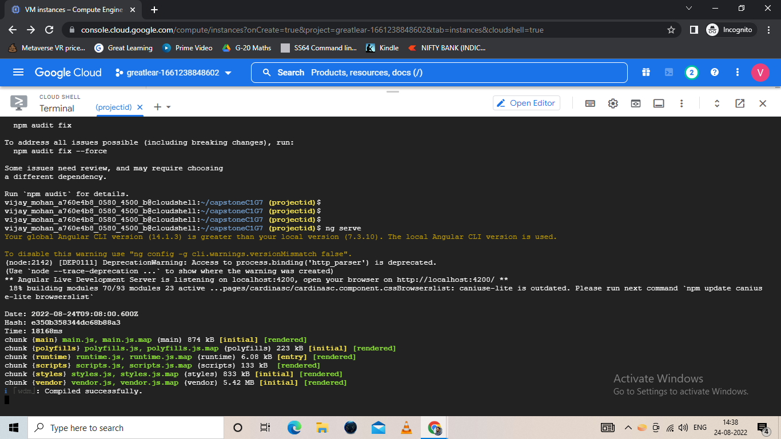

Slide 41
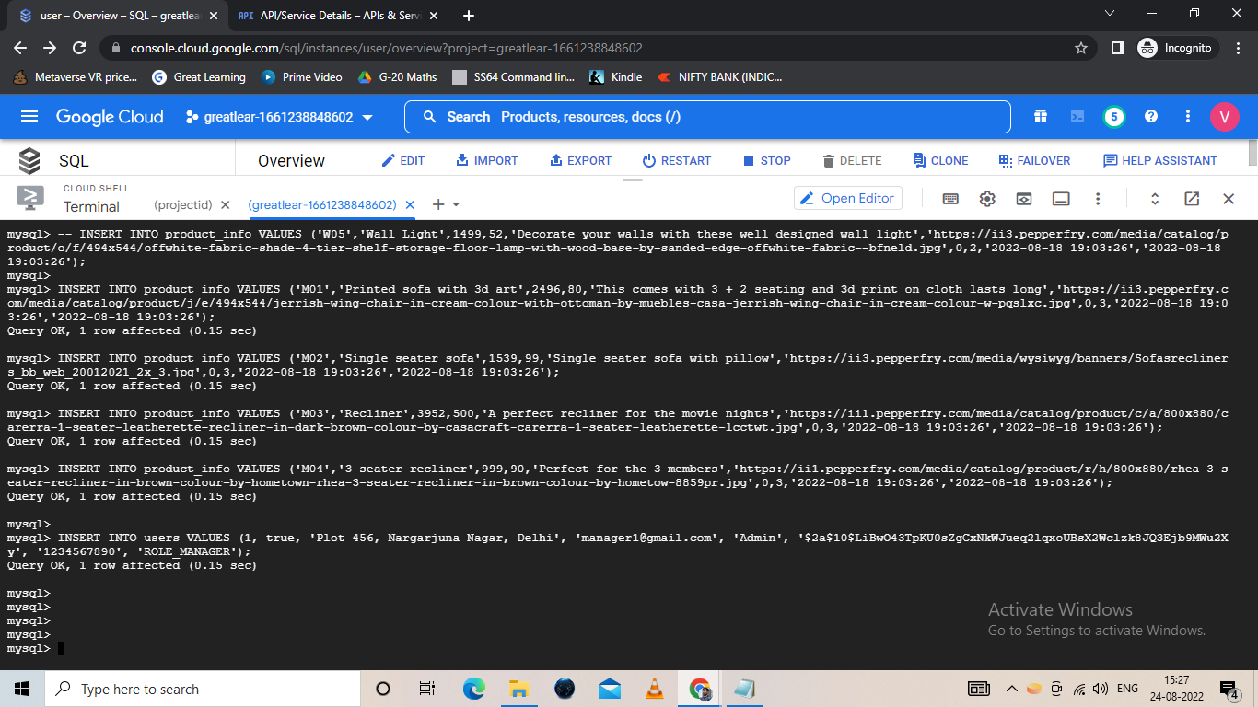

Slide 42
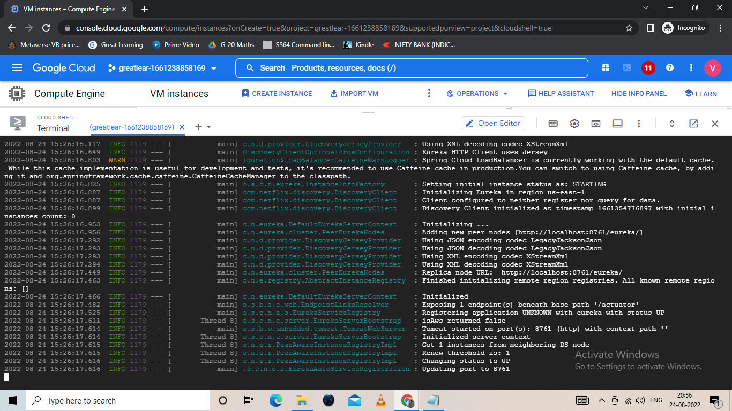

Slide 43
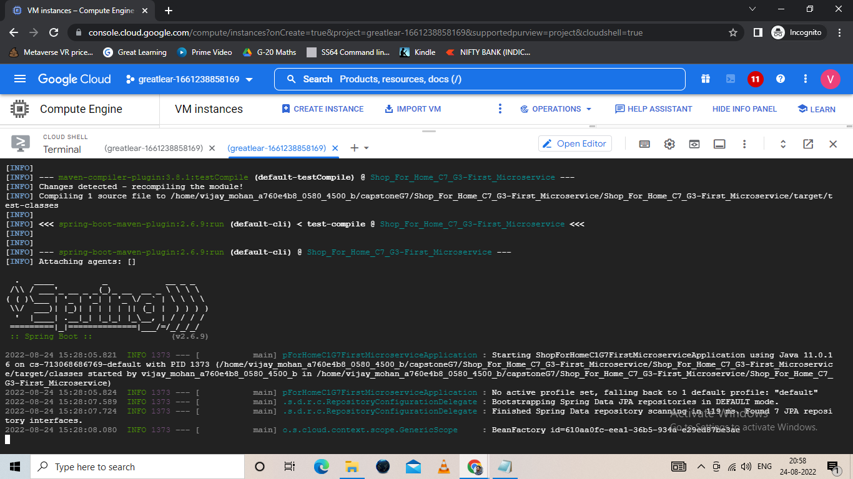

Slide 44
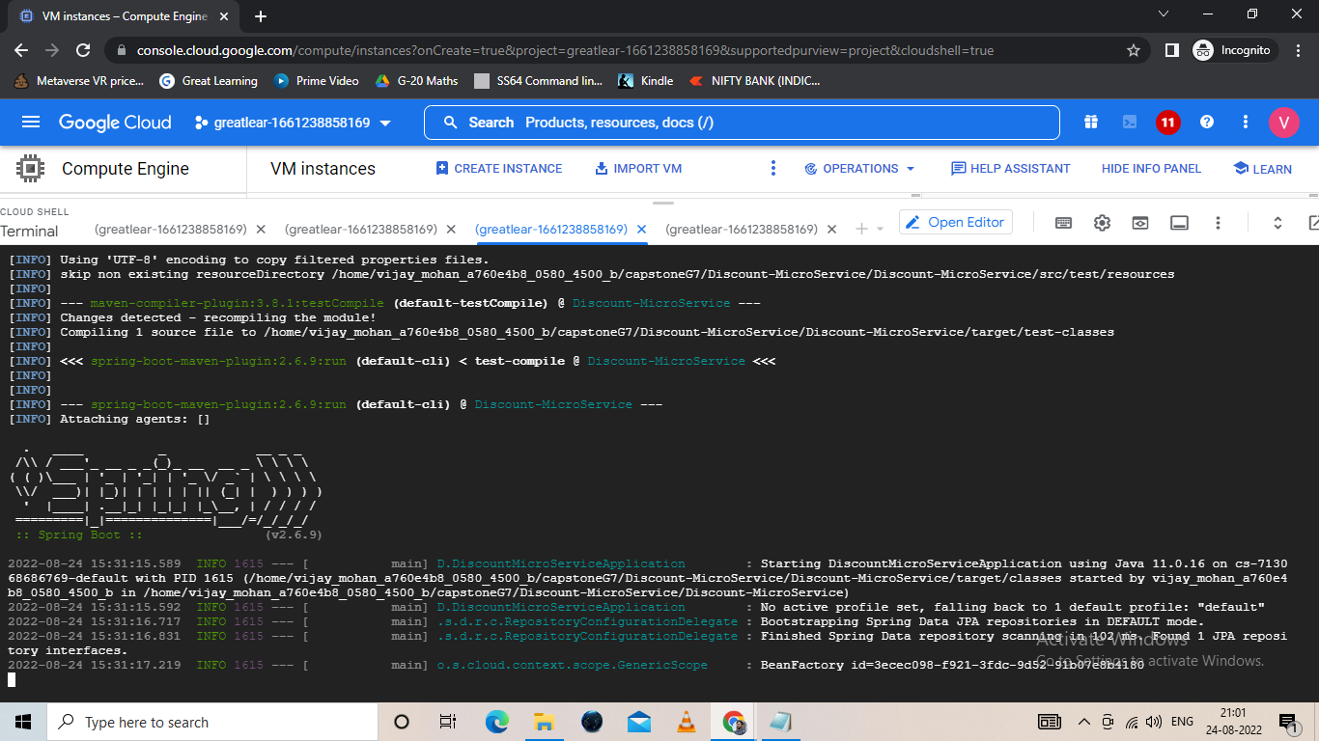

Slide 45
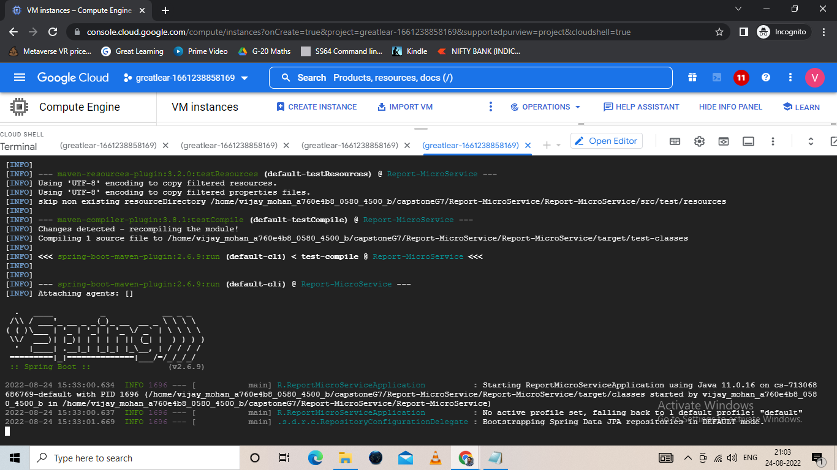

Slide 46
ThankYou

